Slide 1
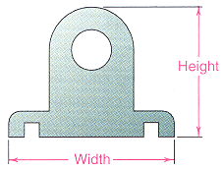

Exercise: Sketching in 2-D
Follow steps 1 through 4 and re-sketch the object’s front view
Capture main proportions
Block-in main features
Add details
Darken lines
width = height = depth

Slide 2

Solution
width = height = depth

Slide 3
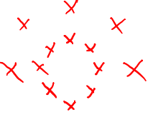
Solution
width = height = depth

Slide 4
Solution
width = height = depth

Slide 5
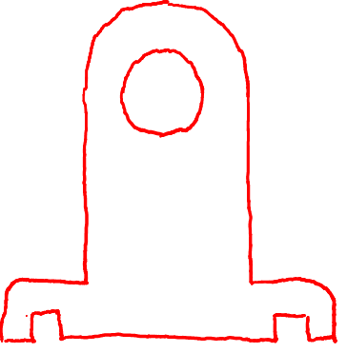
Solution
width = height = depth

